Slide 1
Entity Framework (Core) Unchained
Getting the Best Performance from Your ORM
Dan Mallott

Slide 2
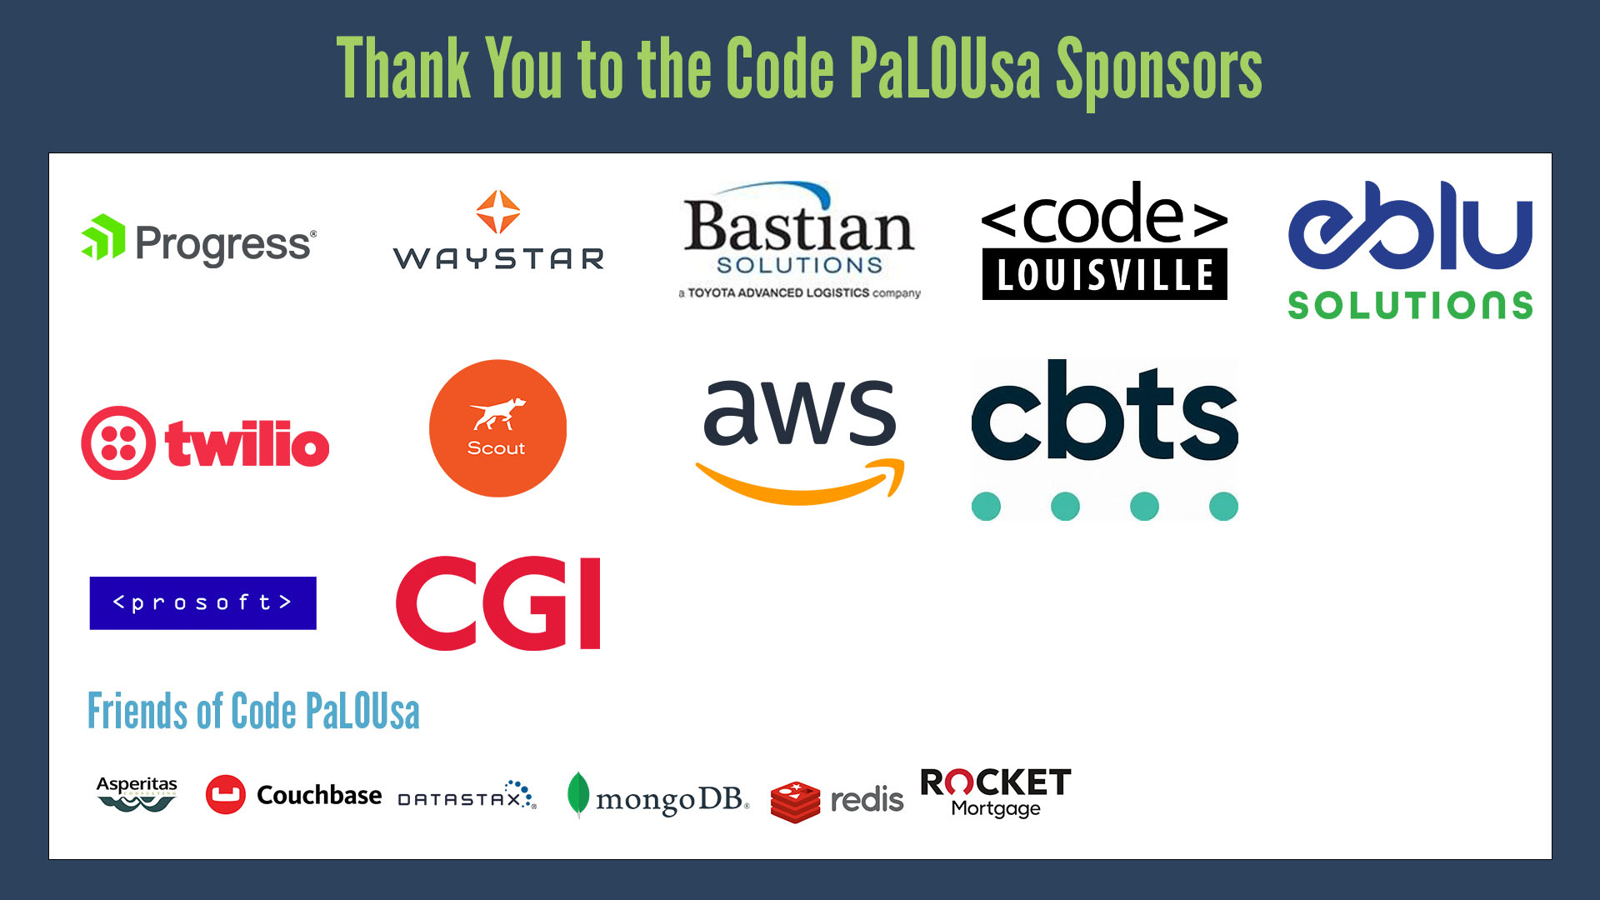

Slide 3


AGENDA
Configuration – The Defaults May Let You Down…
Access Patterns – Not All CRUD Is Created Equally
WARNING! – Easy Ways to Shoot Yourself in the Foot
Database Design – You Only Get One Chance
Eject! – Let’s Be Honest About Things EF Core Is Bad With
Question Time

Slide 4
First, a Quick Introduction

Slide 5

DAN MALLOTT
1
SENIOR PRINCIPAL FOR WEST MONROE
2
DEVELOPING SOFTWARE SINCE 2011
3
STARTED AS A DBA – NOW A DEVELOPER
4
PRIMARY EXPERIENCE WITH MICROSOFT TECHNOLOGIES
5
ALSO, A USA (ICE) HOCKEY REFEREE
Twitter: @DanielMallott
GitHub: https://github.com/danielmallott
LinkedIn: https://www.linkedin.com/in/danielmallott
Notes:
Show the # of ideas in each phase so we focus more on

Slide 6
What Is Entity Framework Core, Again?
01
Object Relational Mapper
Entity Framework Core executes and maps the results of queries from the database into C# objects and keeps track of object state so changes can be saved back to the database
02
Query Generator
To accomplish its role as an Object Relational Mapper, Entity Framework Core also includes powerful abilities to generate both DDL and DML in the language of the database being used

Slide 7
Configuration – The Defaults May Let You Down…

Slide 8
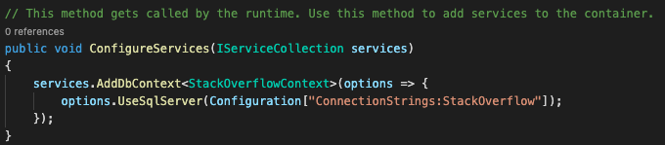
What Are the Defaults?
CONFIGURATION
NO QUERY RETRY ENABLED
ALL QUERIES ARE TRACKED
RELATED ENTITIES EXPLICITLY LOADED
LIMITED LOGGING OF ERRORS AND WARNINGS

Slide 9
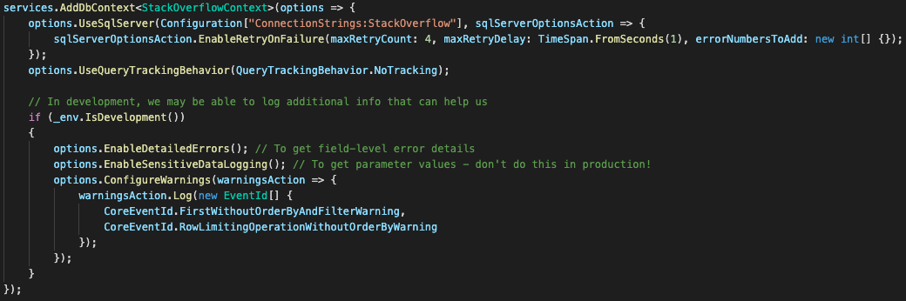
These Aren’t All Bad…
CONFIGURATION
DOS AND DON’TS
DO
Implement a retry policy
Use the proper tracking behavior
DO
Log errors and warnings in the development environment
DON’T
Enable Lazy or Eager loading proxies
A SUGGESTED CONFIGURATION

Slide 10
A Little Bigger For Those In the Back
CONFIGURATION

Slide 11
Access Patterns – Not All CRUD Is Created Equally

Slide 12
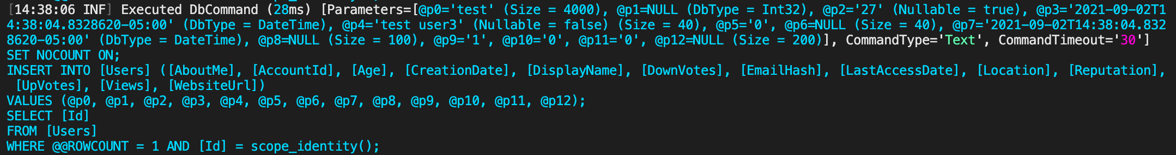
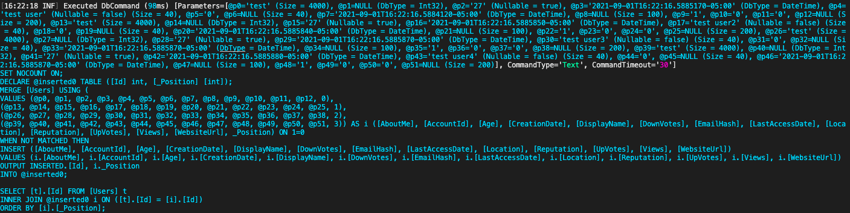
Inserting Records – Our First Headscratcher
ACCESS PATTERNS
If we insert one record, we get one insert statement. Good!
If we insert more than one record…

Slide 13
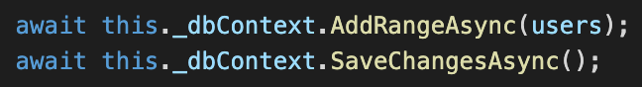
How Did This Happen?
ACCESS PATTERNS
How did these two lines…
Become this monstrosity?

Slide 14
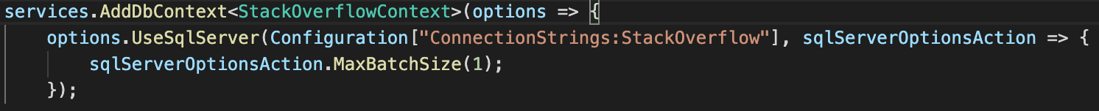
The Method to the Madness
ACCESS PATTERNS
Single Insert Statements are Slow (True-ish)
Inserting Multiple Records is More Efficient (True-ish)
Let’s Use a Merge Statement to Protect Ourselves from Strange SQL Generation Issues!
This is not necessarily a bad choice. While the T-SQL Merge statement has issues (notably with deadlocks), it is more efficient than running single Insert statements
However, in your environment, it may make sense to force single Insert statements – particularly because EF Core uses the Merge statement when there are 3 or more entities to be inserted – by changing the Max Batch Size

Slide 15
Reading Data – The Clear Choice
ACCESS PATTERNS
If you are going to simply return the data or plan on using it to do data processing but are not making modifications to the original entities, choose AsNoTracking() to reduce query overhead
If you are going to be modifying the original entities and saving them back or using them in a way that requires change tracking, choose AsTracking(), even though there is slightly more query overhead
AsTracking()
AsNoTracking()

Slide 16
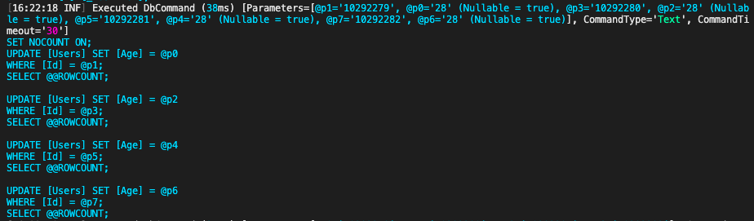
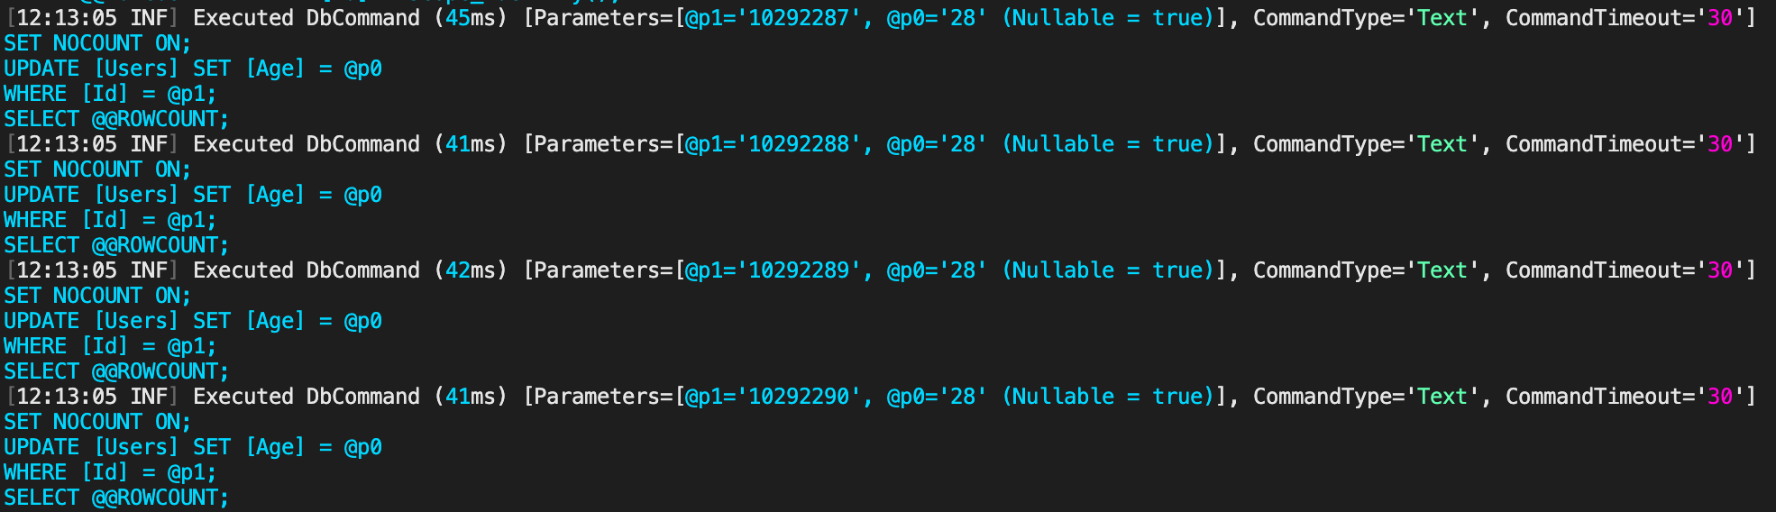
Updates and Deletes – It Is What It Is
ACCESS PATTERNS
Unlike the Insert statement, Updates and Deletes always happen as single statements. Changing the Max Batch Size only limits how many are sent to the database at once

Slide 17
WARNING! – Easy Ways to Shoot Yourself in the Foot

Slide 18
We Have Already Seen Some
WARNING!
1
Bulk Manipulation of Data
2
Lazy Loading Entities
3
Using Tracking for Read Only Scenarios
4
Forgetting to Implement a Retry Policy

Slide 19
Other Ways to Destroy Performance
WARNING!
ISSUE
Using the autogenerated entities can result in too much data coming back
Loading too many related tables (or too few) can result in too much data (or not enough – sometimes manifesting itself as a Null Reference Exception)
Not using the –Async() versions of query methods can result in blocking or, in extreme circumstances, thread pool exhaustion
Defeating indexes by not understanding how your database utilizes them
SOLUTION
Use a Select() to get only the needed columns – the generated query will only list the columns needed!
Make sure to only use Include() with data you will need for your current operation!
Always use the –Async() versions of query methods to reduce blocking
Learn a bit about how your database engine chooses which indexes to use

Slide 20
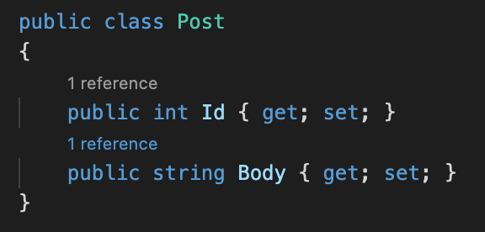
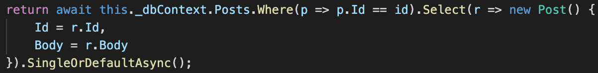

Using .Select() to Limit Fields
WARNING!
By using a custom entity:
And projecting our query:
We get much smaller SQL (which will perform better with large data sets):

Slide 21


To Async or Not to Async
WARNING!
All else being equal, this:
Will perform better than this:
Because the runtime will be able to use the executing thread to do other work. In systems that see few users, the difference is negligible, but under load, you will see more responsiveness

Slide 22
A Note On SQL Server Indexing
WARNING!
Indexes are great – they help speed up retrieval of data
They also slow inserts, updates, and deletes due to needing to update the indexes
String indexes (VARCHAR and NVARCHAR) are only used when there is an equality operation or a trailing wild card (i.e., StartsWith() in C# parlance)
Generally, indexes will not be used when an operation is used on the column in question (e.g., AnswerCount / 2)
Reach out to your DBA team – believe me, they want to help!

Slide 23
Database Design – You Only Get One Chance

Slide 24
General Guidance
DATABASE DESIGN
DO IT RIGHT THE FIRST TIME
POOR DESIGN = POOR PERFORMANCE
You can only design your database the right way once – so get it right the first time! Think about the proper design patterns!
If the original design is poor, we will always be fighting it, and nothing we have talked about will fix the root cause
DESIGN FOR ACCESS PATTERNS
AVOID TABLE PER TYPE
Consider how you are going to be accessing the database – discard pure relational patterns when it makes sense
Mapping entities to tables in a 1:1 fashion seems clean, but ignores that the ORM is meant to solve the mismatch
USE YOUR DATABASE’S TOOLS
AVOID CODE FIRST TOOLS
Understanding the features your database provides (like views, computed columns, and the like) can reduce the processing needed
Code first tools are great for fast starts or small applications; however, they do not scale well with enterprise applications and processes

Slide 25
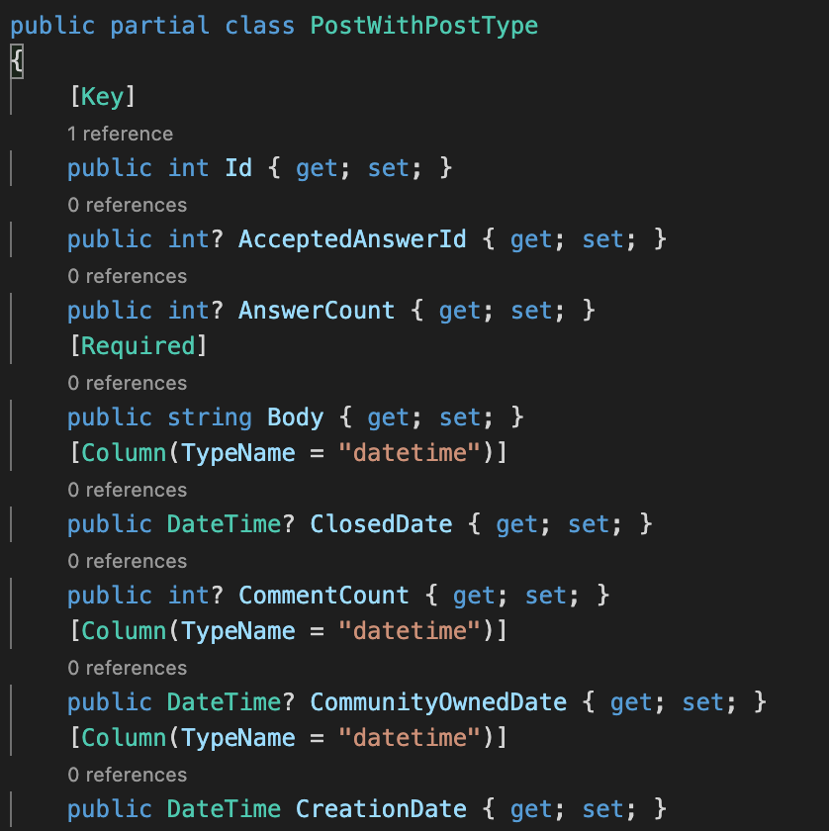
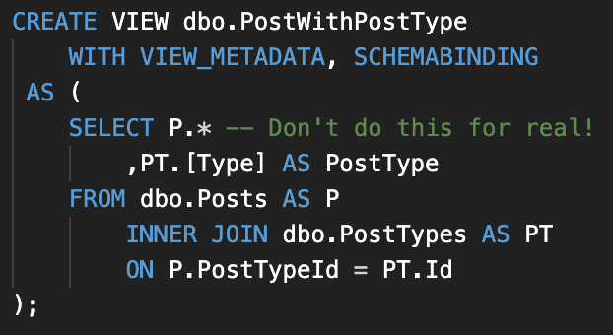
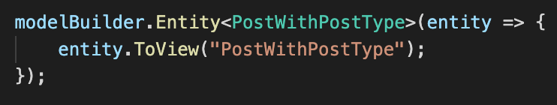
A View to Admire
DATABASE DESIGN
If you find yourself using a lot of Include() or Join() statements, you may want to consider using a view and a different entity definition

Slide 26
Code First Pitfalls
DATABASE DESIGN
DATA TYPES
Entity Framework Core chooses some nasty defaults if you do not specify differently – there may not be a need to store every string field as NVARCHAR!
INDEXES
No columns (except Primary Keys) are indexed by default, and adding indexes to tables with data can cause performance issues when migrations are run
VIEWS
Views must be written manually, which is the same as if you were not using Code First!
ADVANCED FEATURES
Code First will generally not utilize more advanced database features, such as table partitioning or user-defined types. These may be needed, depending on the size of your data!

Slide 27
Eject! – Let’s Be Honest About Things EF Core is Bad With

Slide 28
Complex Data Operations
EJECT!
ETL (or ELT)
Lots of Joins
Parameter Issues
If you have a lot of joins in your query (or Include() statements), EF Core is going to struggle to produce good SQL
Handling ETL operations is something that is best left to ETL tools. EF Core’s overhead renders it very inefficient with large data operations
Sometimes you will run into a parameter issue where the database is just doing the wrong thing and you will need to write specific SQL to fix it

Slide 29
Providing the Best Performance
Entity Framework Core’s primary goal is reliable execution, so the SQL it generates will not be the most performant (especially against Cosmos DB)
EJECT!
There is significant overhead associated with change tracking and the context remembering all of your entities. Under certain circumstances, this can be a benefit; however, you will never see the same performance as you can get with raw ADO.NET or something like Dapper

Slide 30
Lastly, Some Guiding Words
EJECT!
02
Measure Performance at Every Step
Understand How EF Core Works (and Doesn’t Work)
01
03
Have a Plan to Fix It When It Goes Bump

Slide 31
Questions

Slide 32
Thank YOU!
@danielmallott
https://github.com/danielmallott
https://linkedin.com/in/danielmallott

